Slide 1



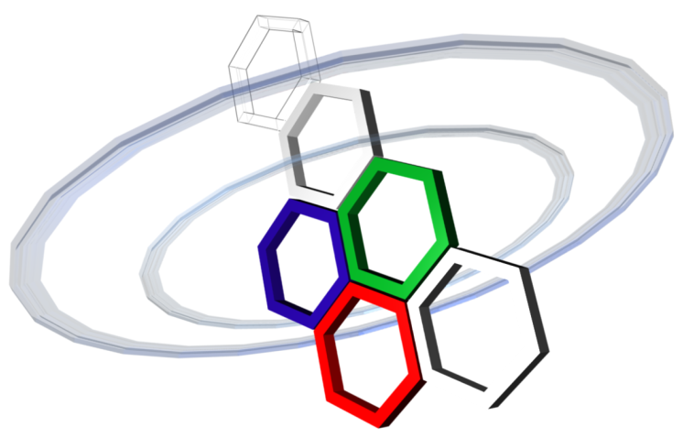
Spatial Data Focusing:
An alternative to Beamforming for geocasting scenarios
Julien Sarrazin, Michael Odhiambo
Sidney Golstein, Philippe De Doncker, François Horlin
GEOHYPE project
ANR funding - JCJC program

Slide 2
GEOcasting for HYPEr resolution spatial data focusing
Goal: Wireless broadcasting of geolocalized data
Applications:
Interactive contents in museums
Danger areas indication for visual impaired persons (zebra crossings…)
Alert people within an area of sudden emergency
GEOHYPE system does not know users location
User privacy is respected
Lighter infrastructure

Slide 3


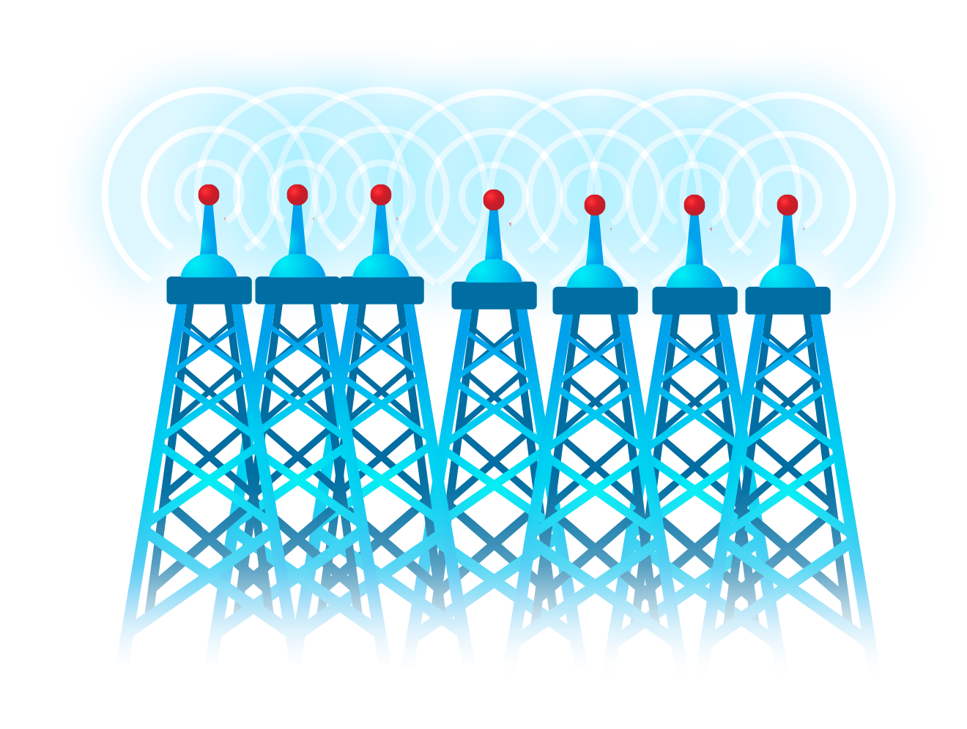


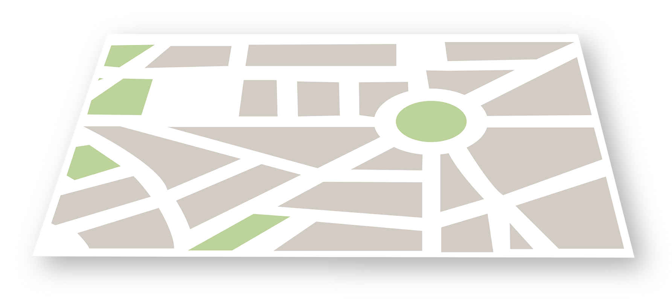
Phased array: power focusing
Broadcasting
The data is being send to the location, whether a user is there or not
Power focusing
Physical limitation: beamwidth is related to aperture size of the array

Slide 4
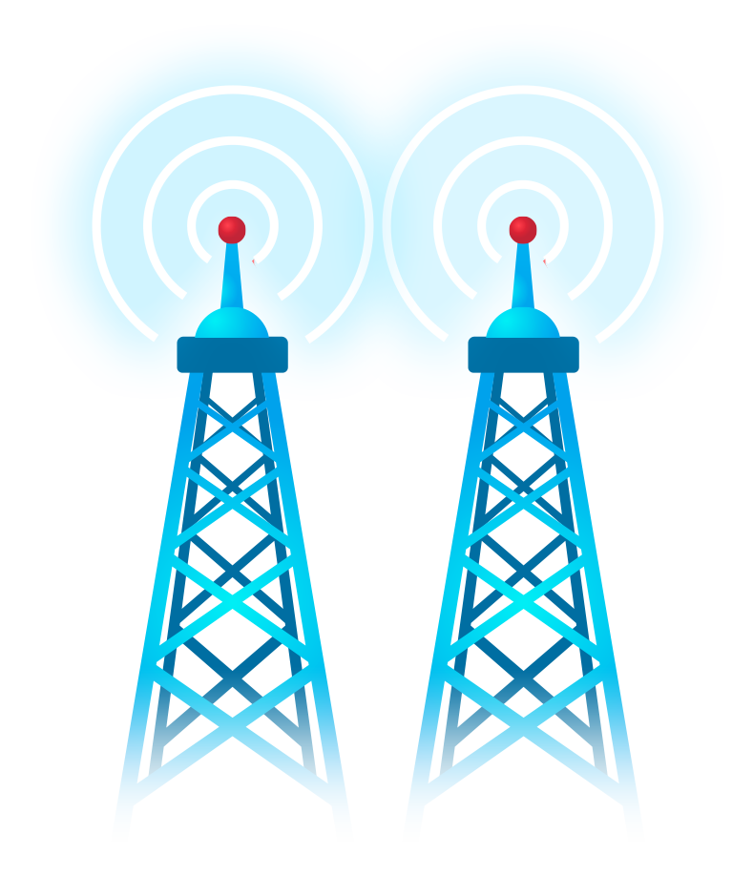
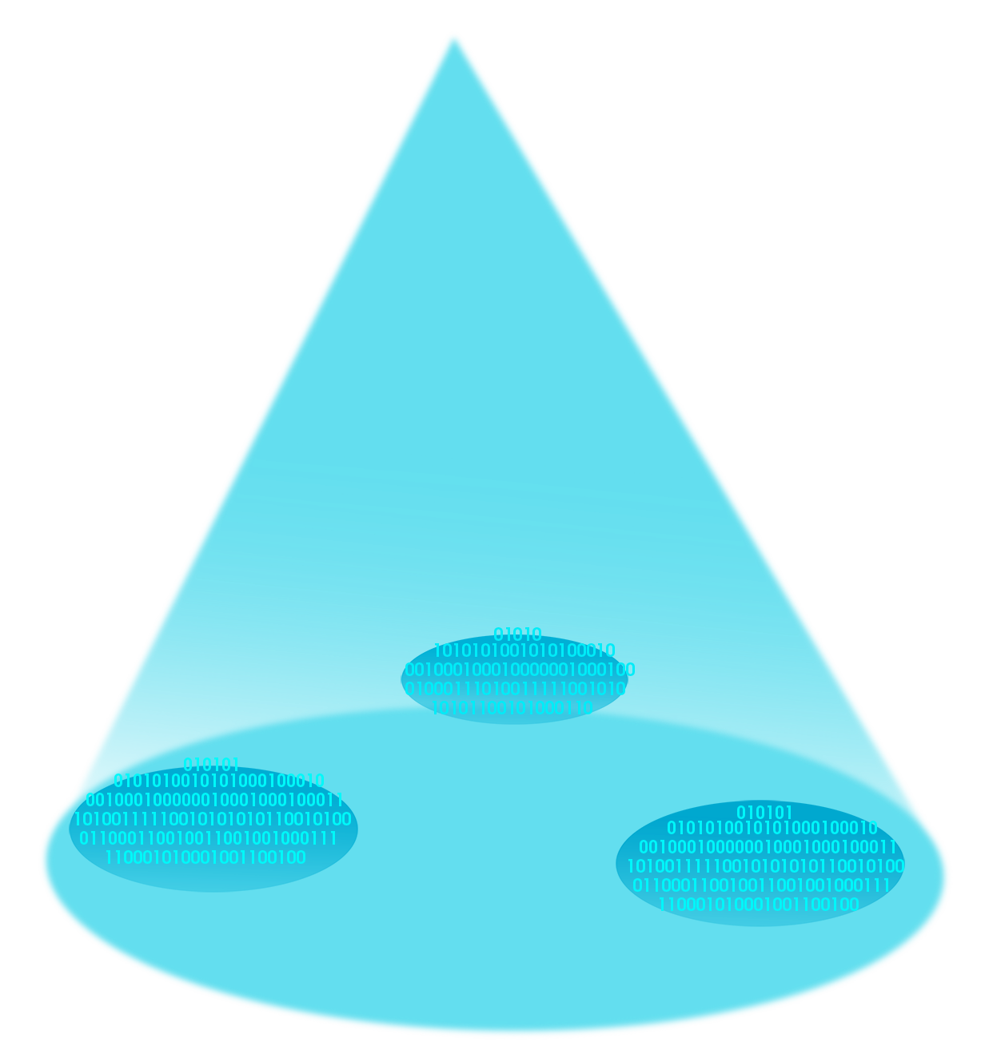
Spatial Data Focusing instead of power focusing

Slide 5
Spatial Data Focusing
Principle

Slide 6
Spatial Data Focusing
Example of a
2 antennas - 2D scenario
using IQ resources
- Simulations -

Slide 7


Spatial Data Focusing
Example of Spatial Data Focusing: 2D IQ scenario
MISO configuration:
- Dual-antenna @ TX
- Single antenna @ RX
θ=16°
θ=4°
Q
$$x_{1}\left(t\right)=x_{I}\left(t\right)$$
θ=0°
I
$$x_{2}\left(t\right)=x_{Q}\left(t\right)$$

Slide 8
Spatial Data Focusing
Example of Spatial Data Focusing: 2D IQ scenario
Received k^{th} estimated symbol (I projection only):
Q
I
3 concomitant effects can be observed:
The correct y_{I}[k] amplitude is affected by a factor f(Δτ/2)cos π f_{c} Δτ
Influence of Inter-Symbol-Interferences (ISI)
The projection of the symbol on the Q dimension is not perfect and therefore, part of the energy will be found onto the I dimension

Slide 9
Spatial Data Focusing: 2D IQ scenario
Focusing effect: BER = f(θ)
Beamwidth @ BER = 10⁻³
BF:
Δθ = 51°
SDF:
Δθ = 6.3°
16-QAM, f = 2.4 GHz, f_{d} = 20 MHz, b = 0.8 λ, SNR = 20 dB (perfect synchronization)

Slide 10
Spatial Data Focusing
Example of a
N antennas – ND scenario - Simulation -

Slide 11
Spatial Data Focusing
N dimensions
N pulses orthogonal in time
N orthogonal codes
N orthogonal subcarriers
…

Slide 12
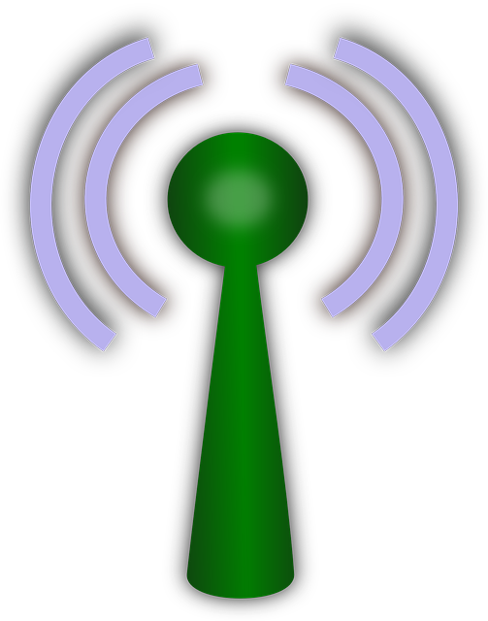
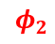
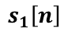
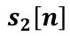
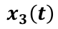
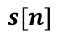
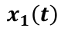
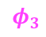
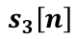

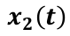
Spatial Data Focusing
Φ₂
Φ₁
Front-End
Front-End
Front-End
N PAM modulations
1 per antenna
Φ₃
$$x_{1}\left(t\right)$$
$$x_{2}\left(t\right)$$
$$x_{3}\left(t\right)$$
$$φ_{1}$$
*
$$φ_{2}$$
*
$$φ_{3}$$
*
$$s_{1}\left[n\right]$$
$$s_{2}\left[n\right]$$
$$s_{3}\left[n\right]$$
3-dimension mapping
$$s[n]$$

Slide 13
Spatial Data Focusing
BER results: comparison between power and data focusing
Beamwidth @ BER = 10⁻³
BF using 16QAM:
Δθ = 51° (N = 2)
Δθ = 31° (N = 3)
SDF:
Δθ = 24° (N = 2)
Δθ = 12.5°(N = 3)
f = 2.4 GHz, f_{d} = 20 MHz, b = 0.8 λ, M = 16 for N = 2, M = 64 for N= 3 (perfect synchronization)

Slide 14
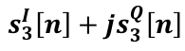
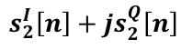
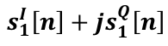
Spatial Data Focusing
Use time resources:
N orthogonal pulses
Use IQ resources:
2N dimensions
N antennas and 2N dimensions
Front-End
Front-End
Front-End
N QAM modulations
1 per antenna
$$x_{1}\left(t\right)$$
$$x_{2}\left(t\right)$$
$$x_{3}\left(t\right)$$
$$φ_{1}$$
*
$$φ_{2}$$
*
$$φ_{3}$$
*
$$s_{1}^{I}\left[n\right]+js_{1}^{Q}\left[n\right]$$
$$s_{2}^{I}\left[n\right]+js_{2}^{Q}\left[n\right]$$
$$s_{3}^{I}\left[n\right]+js_{3}^{Q}\left[n\right]$$
6-dimension mapping
$$s[n]$$

Slide 15
Spatial Data Focusing
BER results: comparison between power and data focusing (with channel estimation)
N = 2 antennas - 4 dimensions (I₁+jQ₁ & I₂+jQ₂)
N = 3 antennas - 6 dimensions (I₁+jQ₁ & I₂+jQ₂ & I₃+jQ₃)
Beamwidth @ BER = 10⁻³
BF:
Δθ = 51°(N = 2)
Δθ = 31°(N = 3)
SDF:
Δθ = 3.3°(N = 2)
Δθ = 1.8°(N = 3)
Notes:
SNR = 20dB
Channel assumed constant during the frame

Slide 16
Spatial Data Focusing
Example of a
2 antennas - 4D scenario
- Measurements -

Slide 17
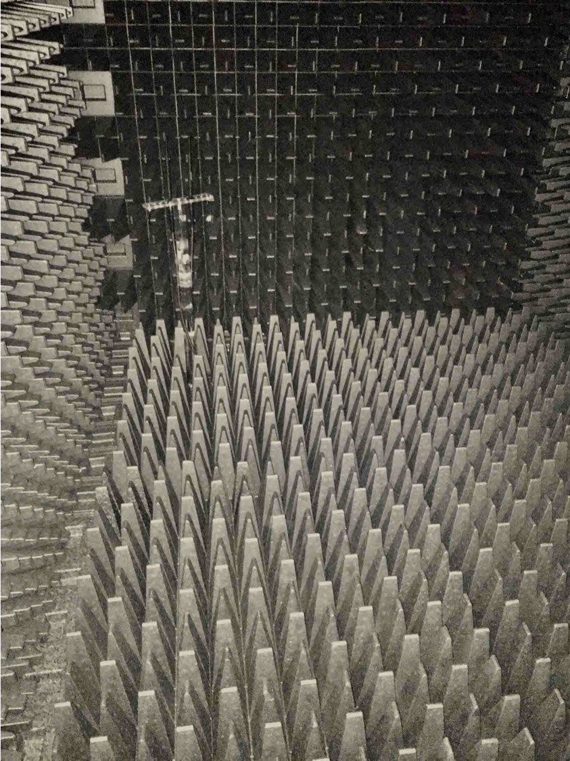
Spatial Data Focusing
Measurement Setup
AWG (2 x 12 GSa/s)
Scope (40 GSa/s)

Slide 18
Spatial Data Focusing
Measurement Results
N = 2 antennas - 4 dimensions (I₁+jQ₁ & I₂+jQ₂)
Parameters
f_{c} = 2.67 GHz
b = 0.8 λ
f_{d} = 20 MHz
Beamwidth @ BER = 10⁻³
SDF:
Δθ = 17.4° (M = 16)
Δθ = 4.1° (M = 256)
Noise robustness equivalence
M = 16 ⬄ QPSK
M = 256 ⬄ 16QAM
1D = 1 bit
1D = 2 bits

Slide 19
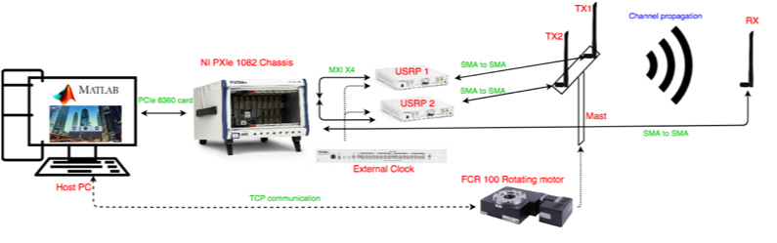
Spatial data focusing (SDF)
On-going
Orthogonal-code-based N-dimensions SDF
Orthogonal-frequency-based N-dimensions SDF
Channel assessment
More antennas:
Perspectives
Channel estimation and equalization
Carrier recovery
N-Dimension dedicated mapping
Protocol aspects
Looking for collaborations

Slide 20
Channel EQ
θ = -32°
N = 2 antennas, 4 dimensions using orthogonal pulses and IQ resources
I₁Q₁
I₂Q₂
I₁I₂
Q₁Q₂
Channel estimation
Magnitude estimated on the 4D symbol
Phase estimated from the 2D of the 1st antenna
Notes:
SNR = 20dB, N = 2

Slide 21
Spatial Data Focusing: Constellation analysis
Example of Spatial Data Focusing: 2D IQ scenario
Distance between TX antennas: b = 0.75λ

Slide 22
Spatial Data Focusing
SDF VS Beamforming: 16QAM
16.6°
5.6°

